Slide 1
Algo CUP 2016
Fire ants edition

Slide 2
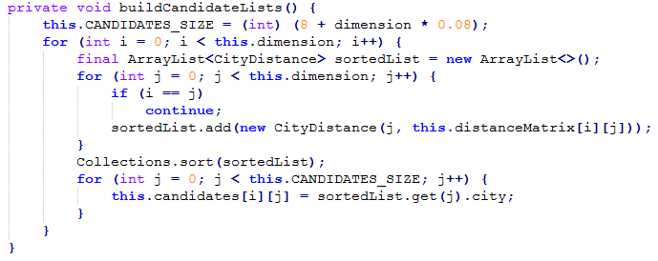
Candidates Lists
Sorted lists
8 candidates + 8%
Huge building cost

Slide 3
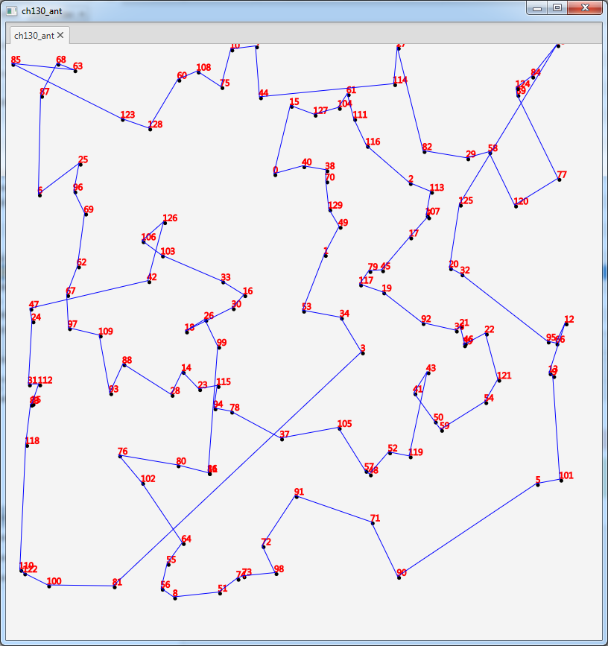

Nearest Neighbor
Usual implementation
Candidates Lists

Slide 4
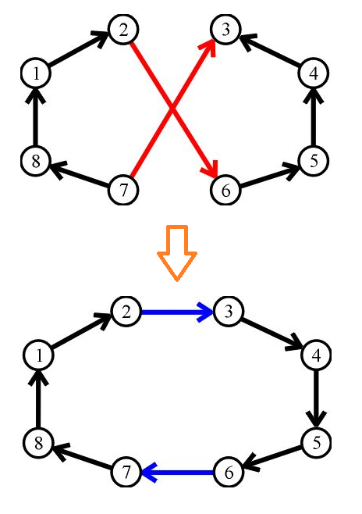


Local Search
2-Opt
First improvement
Full search
Candidate Lists
Always Swap

Slide 5
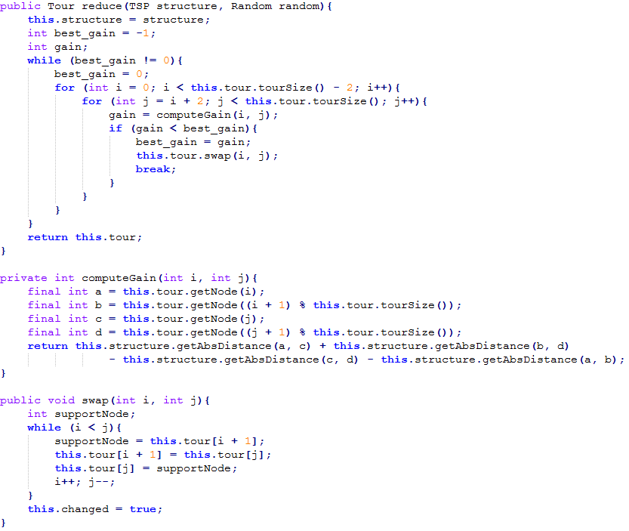
Local Search

Slide 6
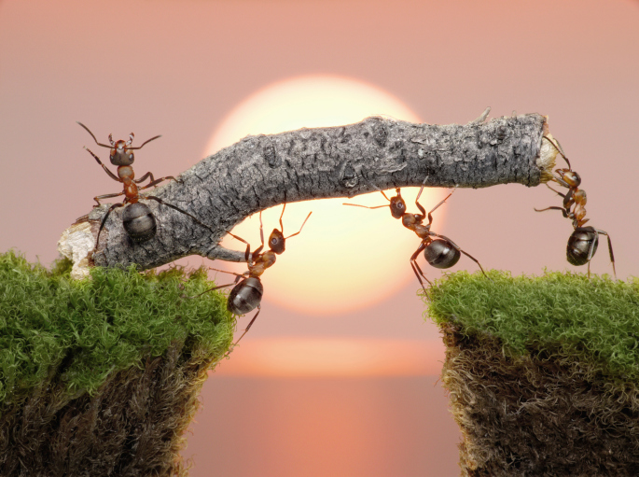
Metaheuristic optimization
Fire Ants Colony System
Candidates lists
Memory Ants (“genetic ants”)
BAE (Best Ant Ever)
Lone Ant

Slide 7
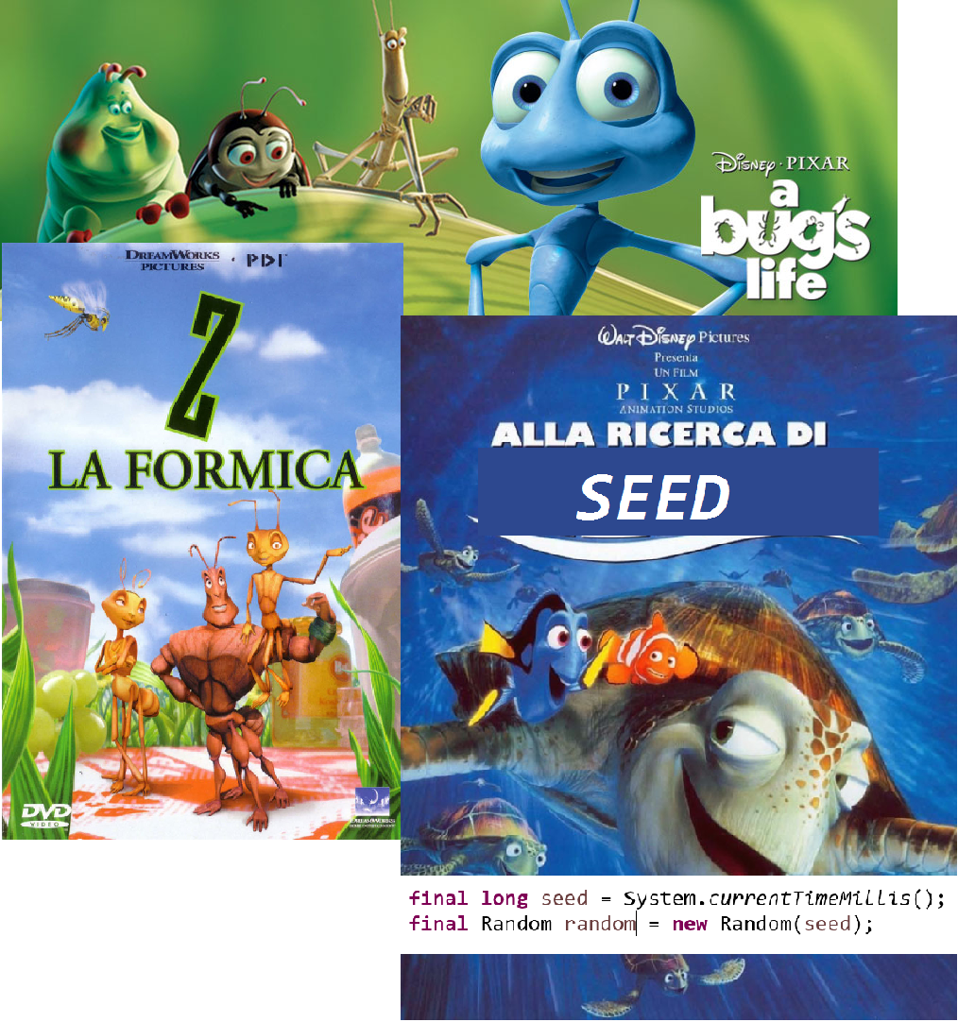
Solutions approach
Parallel seeding
Code profiling
Optimization of the code
Luck

Slide 8
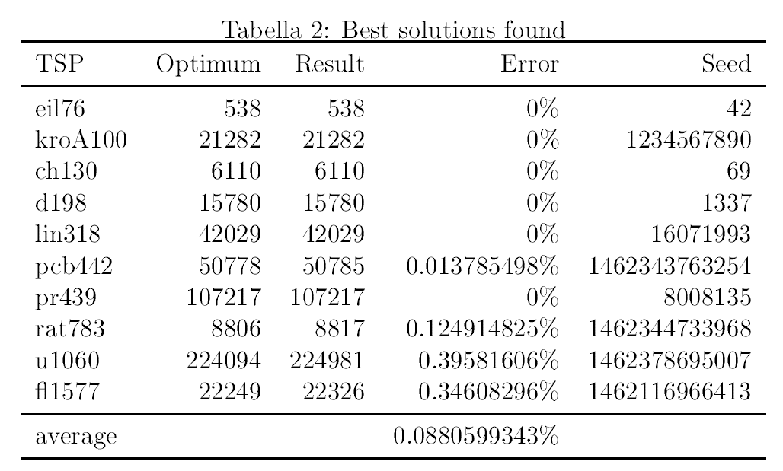
Results

Slide 9

Freely available on Git
http://git.storni.info/Nikooo777/TSPCup/tree/final_copy
Or check out https://github.com/nikooo777 (I might upload it here too)

